Slide 1

Unit-9: Connectionist Models
Artificial Intelligence (AI)
3170716
Dr. Gopi Sanghani
Computer Engineering Department
gopi.sanghani@darshan.ac.in
9825621471

Slide 2

Outline
Introduction
Hopfield Network
Learning In Neural Network
Application of Neural Networks
Recurrent Networks
Distributed Representations
Connectionist AI And Symbolic AI
Looping

Slide 3
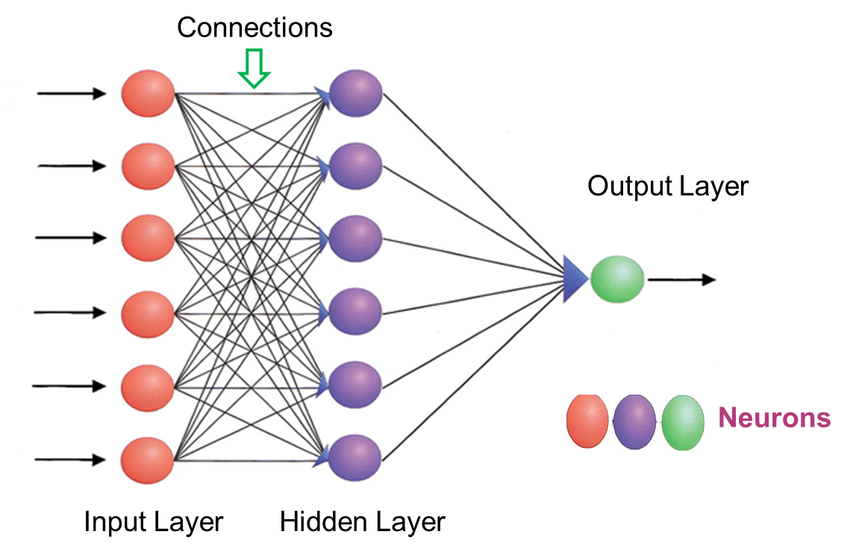
Introduction
Neural network architectures have been called connectionist architecture.
They are characterized by having:
A very large number of simple neuron-like processing elements.
A large number of weighted connections between the elements. The weights on the connections encode the knowledge of a network.
Highly parallel and distributed control.
An emphasis on learning internal representations automatically.

Slide 4
Hopfield Network
Hopfield neural network is proposed by John Hopfield in 1982 as a theory of memory: Model of content addressable.
Human memory works in an associative or content-addressable way.
There is no location in the neural network in the brain for a particular memory of an individual.
Rather, the memory of the individual is retrieved by a string of associations about the physical features, personality characteristics and social relations of that individual, which are dealt by different parts of the brain.
Using advanced imaging technique, a sophisticated pattern of activation of various neural regions is observed in the process of recalling an individual.
Human beings are also able to fully recall a memory by first remembering only particular aspects or features of that memory.

Slide 5
Hopfield Network
Hopfield network is a special kind of neural network whose response is different from other neural networks.
It is calculated by converging iterative process. It has just one layer of neurons relating to the size of the input and output, which must be the same.
When such a network recognizes, for example, digits, we present a list of correctly rendered digits to the network. Subsequently, the network can transform a noise input to the relating perfect output.
Here, a neuron is either in on or off situation. The state of a neuron(on +1 or off 0) will be restored, relying on the input it receives from the other neuron.
A Hopfield network is at first prepared to store various patterns or memories. Afterward, it is ready to recognize any of the learned patterns by uncovering partial or even some corrupted data about that pattern, i.e., it eventually settles down and restores the closest pattern.

Slide 6
Simple Hopfield Network
The Hopfield network(model) consists of a set of neurons and corresponding set of unit delays, forming a multiple loop feedback system.
Processing elements or units are always in one of two states, active or inactive.
In the figure, units colored black are active and units colored white are inactive.
Units are connected to each other with weighted symmetric connections. A positive weighted connection indicates that the two units tend to activate each other.
A negative weighted connection allows an active unit to deactivate a neighboring unit.
-1
-1
+1
+3
-1
+2
+1
+3
-2
+1
-1

Slide 7
Simple Hopfield Network
The network operates as follows (Parallel relaxation algorithm):
A random unit is chosen
If any of it neighbors are active, the unit computes the sum of the weights on the connections to those active neighbors.
If the sum is positive, the unit becomes active, otherwise it becomes inactive.
Another random unit is chosen, and the process repeats until the network reaches a stable state. (e.g. until no more unit can change state)
Network can be thought of as storing the patterns, given any set of weights and any initial state, the parallel relaxation algorithm will eventually steer the network into a stable state.
Sometimes the network cannot find global solution because the network sticks with the local minima as nodes settle into stable states via a completely distributed algorithm.

Slide 8
Simple Hopfield Network
The network has four distinct stable states.
Given an initial state, the network will necessarily settle into any one of these four possible configurations.
Hopfield’s major contribution was to show that given any set of weights and any initial state, the parallel relaxation algorithm would eventually steer the network into a stable state.
-1
-1
+1
-1
+3
+1
-1
+3
-1
-1
-1
+2
+1
+3
-1
+2
+1
+3
-2
-2
+1
-1
+3
+1
-1
+1
-1
+3
+1
-1
-1
-1
+2
+1
+3
-2
+2
+1
+3
-2
+1
-1
+1
-1

Slide 9
Hopfield Network
Thus, similar to the human brain, the Hopfield model has stability in pattern recognition.
Properties of Hopfield network:
A recurrent network with all nodes connected to all other nodes.
Nodes have binary outputs (either 0,1 or -1,1).
Weights between the nodes are symmetric.
No connection from a node to itself is allowed.
Nodes are updated asynchronously ( i.e. nodes are selected at random).
The network has no hidden nodes or layer.

Slide 10
Artificial Neural Network
An Artificial Neural Network (ANN) is an information processing paradigm that is inspired by the way biological nervous system, such as the brain processes the information.
The brain is a highly complex, nonlinear, and parallel information-processing system.
It has the capability of organizing neurons so as to perform certain computations (e.g. pattern recognition, perception, and motor control) many times faster than the fastest digital computer.
A brain has great structure and the ability to build up its own rules through what we usually refer to as experience.
In its most general form, a neural network is a machine that is designed to model the way in which the brain performs a particular task or function of interest.
The network is usually implemented using electronic components or simulated in software on a digital computer.
To achieve good performance, neural networks employ a massive interconnection of simple computing cells referred to as neurons or processing units.

Slide 11
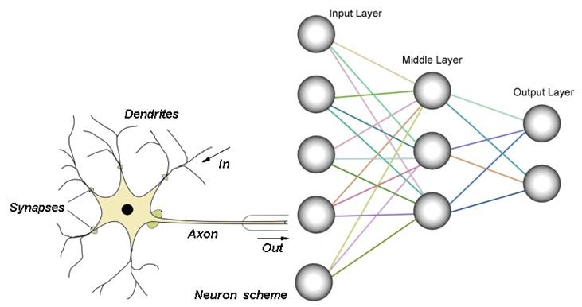
Simple Neural Network
To understand how an artificial neuron works, we should know how the biological neuron works.
Dendrites : These receive information or signals from other neurons that get connected to it.
Cell Body : Information processing happens in a cell body. These take in all the information coming from the different dendrites and process that information.
Axon : It sends the output signal to another neuron for the flow of information. Here, each of the flanges connects to the dendrite or the hairs on the next one.
Synapses are elementary structural and functional units that mediate the interactions between neurons.

Slide 12
Simple Neural Network
The network starts with an input layer that receives input in the form of data.
The lines connected to the hidden layers are called weights, and they add up on the hidden layers.
Each dot in the hidden layer processes the inputs, and it puts an output into the next hidden layer and lastly, into the output layer.
A neural network is a system of hardware or software patterned after the operation of neurons in the human brain.
Neural networks, also called artificial neural networks, are ways of achieving deep learning.

Slide 13
Activation Functions
Neural networks are also referred to as neuro-computers, connectionist networks, parallel Distributed processors, etc.
Knowledge is acquired by the network through a learning process.
Interneuron connection strengths known as synaptic weights are used to store the Knowledge.
An activation function in a neural network defines how the weighted sum of the input is transformed into an output from a node or nodes in a layer of the network.
An activation function is used for limiting the amplitude of the output of a neuron.
Typically, the normalized amplitude range of the output of a neuron is written as the closed unit interval [0, 1] or alternatively [-1, 1].
The choice of activation function has a large impact on the capability and performance of the neural network, and different activation functions may be used in different parts of the model.
Different activation functions used are: Threshold activation function, Sigmoid (logistic) activation function, Softmax activation function, etc.

Slide 14
Learning in Neural Network
ANN is completely inspired by the way biological nervous system, i.e. the human brain works.
The most impressive characteristic of the human brain is to learn, hence the same feature is acquired by ANN.
What is Learning in ANN?
Basically, learning means to do and adapt the change in itself as and when there is a change in environment.
ANN is a complex system or more precisely we can say that it is a complex adaptive system, which can change its internal structure based on the information passing through it.
Why is It important?
Being a complex adaptive system, learning in ANN implies that a processing unit is capable of changing its input/output behavior due to the change in environment.
The importance of learning in ANN increases because of the fixed activation function as well as the input/output vector, when a particular network is constructed.
Now to change the input/output behavior, we need to adjust the weights.

Slide 15
Neural Network Learning Rules
During ANN learning, we need to adjust the weights to change the input/output behavior.
Hence, a method is required with the help of which the weights can be modified.
These methods are called Learning rules, which are simply algorithms or equations.
Following are some learning rules for the neural network −
Hebbian learning rule – It identifies, how to modify the weights of nodes of a network.
Perceptron learning rule – Network starts its learning by assigning a random value to each weight.
Delta learning rule – Modification in weight of a node is equal to the multiplication of error and the input.
Correlation learning rule – The correlation rule is the supervised learning.
Outstar learning rule – We can use it when it assumes that nodes or neurons in a network arranged in a layer.

Slide 16
Perceptron
The perceptron, an invention of (1962) Rosenblatt, was one of the earliest neural network models.
It models a neuron by taking a weighted sum of its inputs and sending the output 1 if the sum is greater than some adjustable threshold value (otherwise it sends 0)
The perceptron model is also known as a single-layer neural network. This neural net contains only two layers: Input Layer and Output Layer
In this type of neural network, there are no hidden layers. It takes an input and calculates the weighted input for each node. Afterward, it uses an activation function (mostly a sigmoid function) for classification purposes.
As being supervised in nature, to calculate the error, there would be a comparison between the desired/target output and the actual output. If there is any difference found, then a change must be made to the weights of connection.

Slide 17
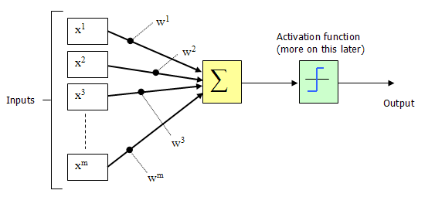

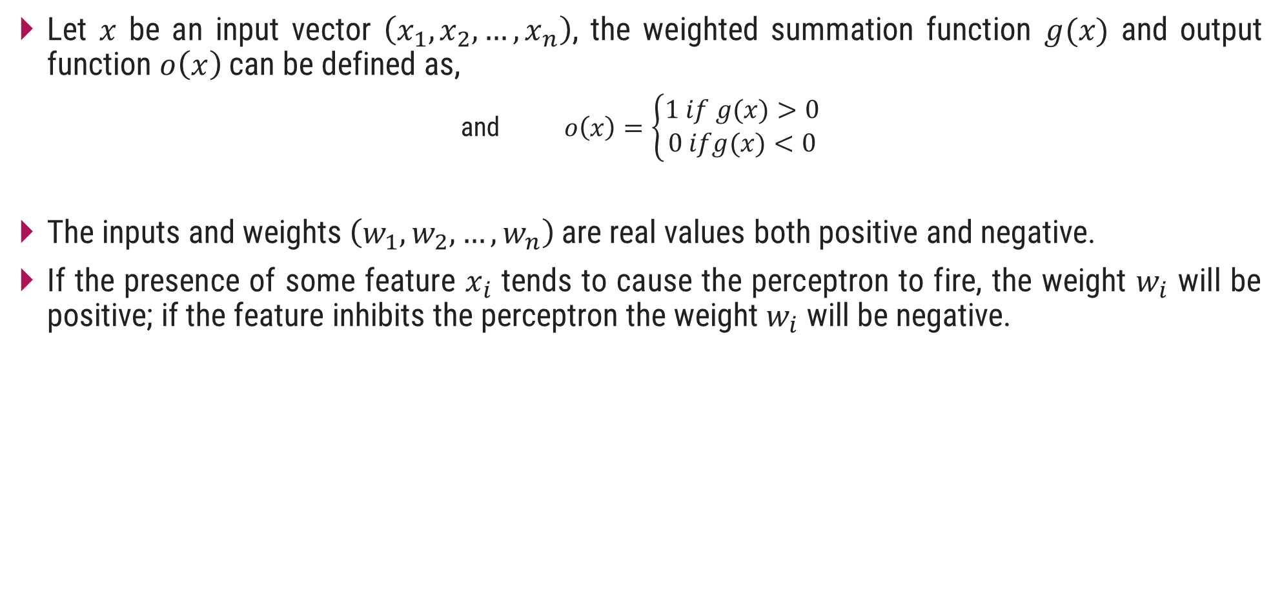
Perceptron
Let $x$ be an input vector $\left(x_{1},x_{2},…,x_{n}\right)$, the weighted summation function $g(x)$ and output function $o\left(x\right)$can be defined as,
and $o\left(x\right)=\left\{\begin{aligned}1 if g(x)>0 \\ 0 ifg(x)<0\end{aligned}\right.$
The inputs and weights $\left(w_{1},w_{2},…,w_{n}\right)$ are real values both positive and negative.
If the presence of some feature $x_{i}$ tends to cause the perceptron to fire, the weight $w_{i}$ will be positive; if the feature inhibits the perceptron the weight $w_{i}$ will be negative.
$$g\left(x\right)=\sum_{i=0}^{n}{W_{i}X_{i}}$$

Slide 18

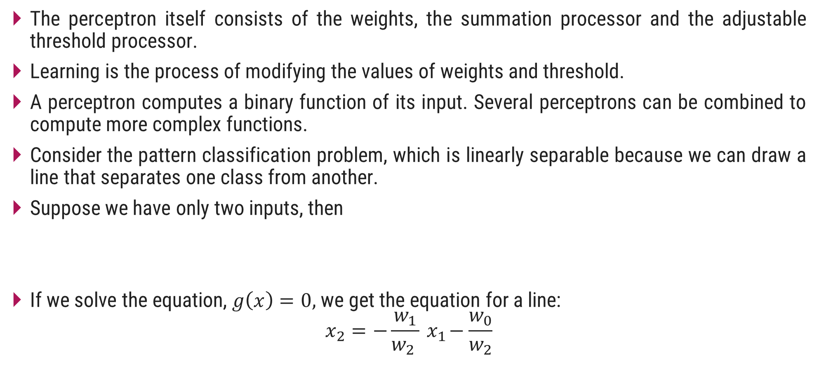
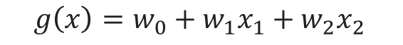
Perceptron
The perceptron itself consists of the weights, the summation processor and the adjustable threshold processor.
Learning is the process of modifying the values of weights and threshold.
A perceptron computes a binary function of its input. Several perceptrons can be combined to compute more complex functions.
Consider the pattern classification problem, which is linearly separable because we can draw a line that separates one class from another.
Suppose we have only two inputs, then
If we solve the equation, $g\left(x\right)=0,$we get the equation for a line:
$$x_{2}=−\frac{w_{1}}{w_{2} }{ x}_{1}−\frac{w_{0}}{w_{2}}$$
$$g\left(x\right)=\sum_{i=0}^{n}{W_{i}X_{i}}$$
So,
$$g\left(x\right)=w_{0}+w_{1}x_{1}+w_{2}x_{2 }$$

Slide 19
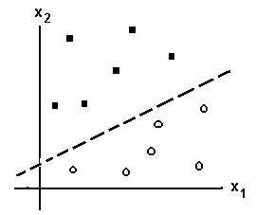

Perceptron
The location of the line is determine by the weight $w_{0},$ $w_{1}$and $w_{2}.$
if an input vector lies on one side of the line, the perceptron will output 1, if it lies on the other side, the perceptron will output 0.
Decision surface: a line that correctly separates the training instances corresponds to a perfectly function perceptron.

Slide 20
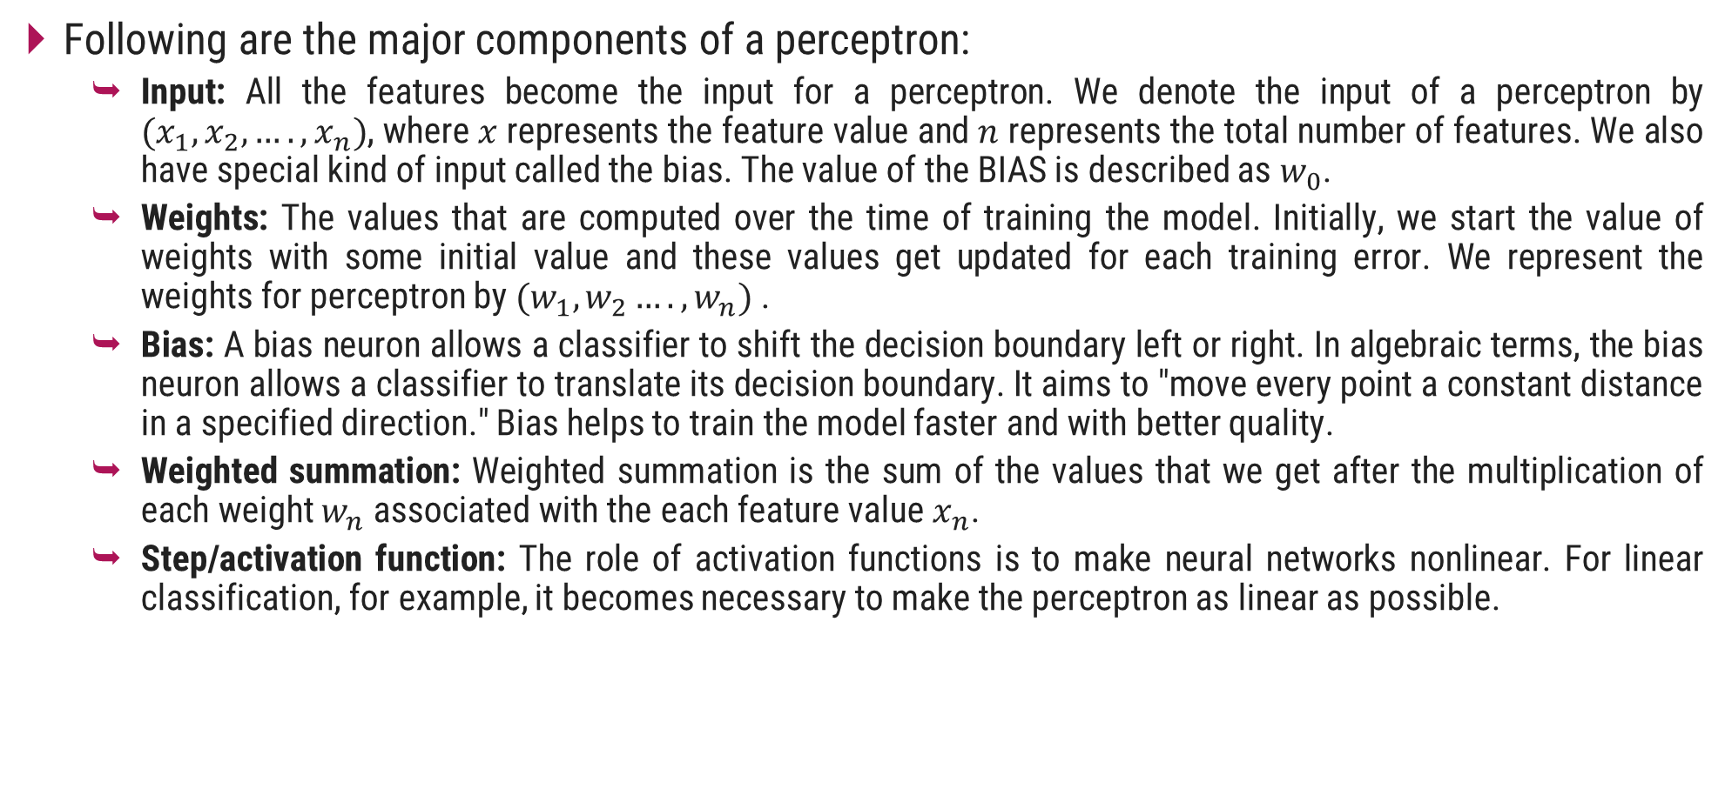
Perceptron Learning Algorithm
Following are the major components of a perceptron:
Input: All the features become the input for a perceptron. We denote the input of a perceptron by $(x_{1}, x_{2}, …., x_{n})$, where $x$ represents the feature value and $n$ represents the total number of features. We also have special kind of input called the bias. The value of the BIAS is described as $w_{0}$.
Weights: The values that are computed over the time of training the model. Initially, we start the value of weights with some initial value and these values get updated for each training error. We represent the weights for perceptron by $(w_{1}, w_{2}…., w_{n})$.
Bias: A bias neuron allows a classifier to shift the decision boundary left or right. In algebraic terms, the bias neuron allows a classifier to translate its decision boundary. It aims to "move every point a constant distance in a specified direction." Bias helps to train the model faster and with better quality.
Weighted summation: Weighted summation is the sum of the values that we get after the multiplication of each weight $w_{n}$ associated with the each feature value $x_{n}$.
Step/activation function: The role of activation functions is to make neural networks nonlinear. For linear classification, for example, it becomes necessary to make the perceptron as linear as possible.

Slide 21
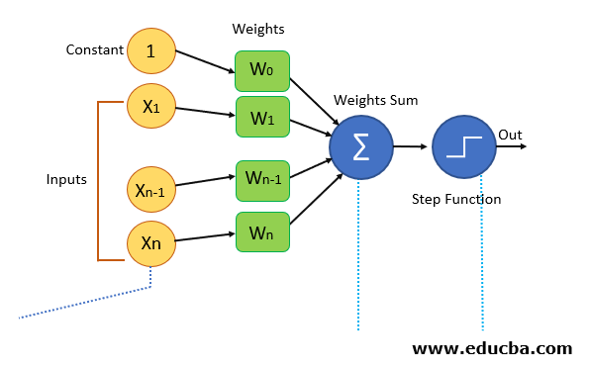
Perceptron Learning Algorithm
Features of the model we want to train should be passed as input to the perceptron in the first layer.
These inputs will be multiplied by the weights or weight coefficients and the production values from all perceptron will be added.
Adds the Bias value, to move the output function away from the origin.
This computed value will be fed to the activation function (chosen based on the requirement, if a simple perceptron system activation function is step function).
The result value from the activation function is the output value.
Image source :

Slide 22
Perceptron Learning Algorithm
The Perceptron algorithm is a two-class (binary) classification machine learning algorithm.
It consists of a single node or neuron that takes a row of data as input and predicts a class label. This is achieved by calculating the weighted sum of the inputs and a bias (set to 1). The weighted sum of the input of the model is called the activation.
The Perceptron is a linear classification algorithm. This means that it learns a decision boundary that separates two classes using a line (called a hyperplane) in the feature space.
As such, it is appropriate for those problems where the classes can be separated well by a line or linear model, referred to as linearly separable.
The coefficients of the model are referred to as input weights and are trained using the stochastic gradient descent optimization algorithm.
Activation = Weights * Inputs + Bias
Predict 1: If Activation > 0.0
Predict 0: If Activation <= 0.0

Slide 23
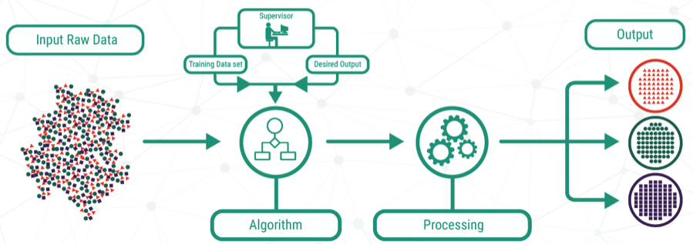
Types of Learning
Supervised Learning:
As the name suggests, supervised learning takes place under the supervision of a teacher.
This learning process is dependent. During the training of ANN under supervised learning, the input vector is presented to the network, which will produce an output vector.
This output vector is compared with the desired/target output vector.
An error signal is generated if there is a difference between the actual output and the desired/target output vector.
On the basis of this error signal, the weights would be adjusted until the actual output is matched with the desired output.
Image source : https://aditi22prerna.medium.com/supervised-learning-a24caf362e79

Slide 24
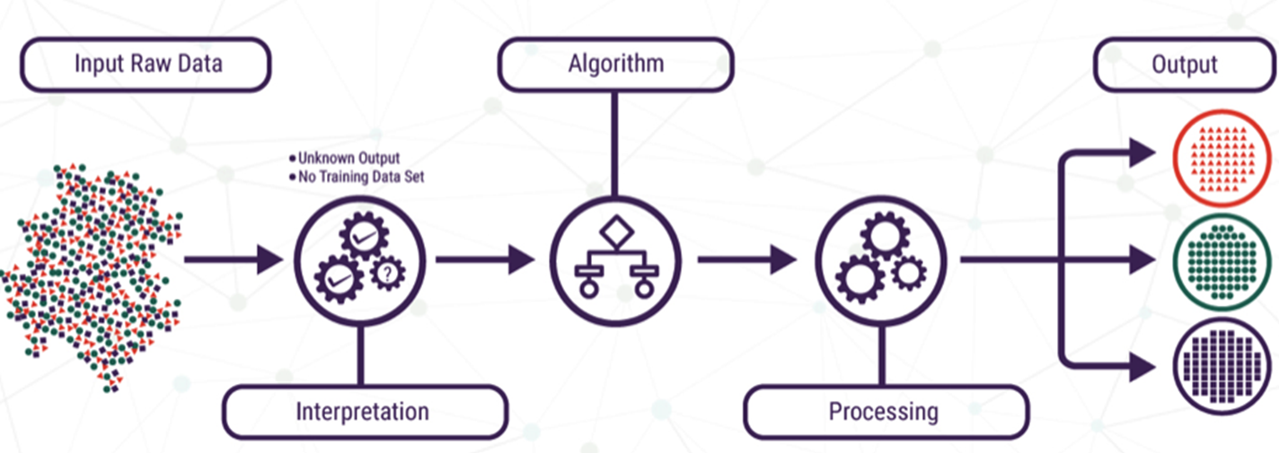
Types of Learning
Unsupervised Learning:
In unsupervised or self-organized learning there is no external teacher to oversee the learning process.
In other words, there are no specific samples of the function to be learned by the network.
Rather, provision is made for a task-independent measure of the quality of representation that the network is required to learn and the free parameters of the network are optimized with respect to that measure.
Once the network has become tuned to the statistical regularities of the input data, it develops the ability to form internal representations for encoding features of the input and thereby creates new classes automatically.
Image source : https://aditi22prerna.medium.com/unsupervised-learning-a24caf362e79

Slide 25
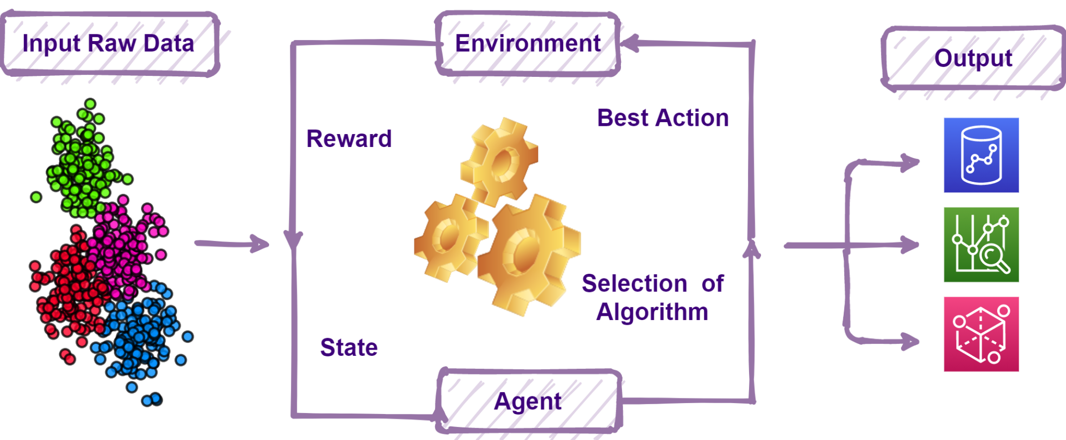
Types of Learning
Reinforcement Learning:
Reinforcement learning is a type of learning that is based on the interaction with environments. The algorithm learns to react to an environment on their own.
Reinforcement learning is learning what to do and how to map situations to actions, so as to maximize a numerical reward signal.
The learner is not told which actions to take, but instead must discover which actions yield the most reward by trying them.
RL models consist of algorithms that use the estimated errors as rewards or penalties. If the error is big, then the penalty is high and the reward low. If the error is small, then the penalty is low and the reward high.
The way reinforcement learning solves problems is by allowing a piece of software called an “agent” to explore, interact with, and learn from the environment.
Image source: https://www.inwinstack.com/blog-en/blog_ai-en/6262/

Slide 26
Recurrent Neural Networks
Recurrent neural networks (RNN) are a class of neural networks that are helpful in modeling sequence data. Derived from feed forward networks, RNNs exhibit similar behavior to how human brains function.
RNNs are a powerful and robust type of neural network, and belong to the most promising algorithms in use because it is the only one with an internal memory.
An increase in computational power along with the massive amounts of data that we now have to work with, and the invention of long short-term memory (LSTM) in the 1990s, has really brought RNNs to the foreground.
Because of their internal memory, RNN can remember important things about the input they received, which allows them to be very precise in predicting what is coming next.
This is why they are the preferred algorithm for sequential data like time series, speech, text, financial data, audio, video, weather and much more.
Recurrent neural networks can form a much deeper understanding of a sequence and its context compared to other algorithms.

Slide 27
How Recurrent Neural Networks Work?
Sequential data is basically just ordered data in which related things follow each other. Examples are financial data or the DNA sequence.
The most popular type of sequential data is perhaps time series data, which is just a series of data points that are listed in time order.
In a feed-forward neural network, the information only moves in one direction — from the input layer, through the hidden layers, to the output layer.
The information moves straight through the network and never touches a node twice.
Feed-forward neural networks have no memory of the input they receive. Because a feed-forward network only considers the current input, it has no notion of order in time.
In an RNN the information cycles through a loop. When it makes a decision, it considers the current input and also what it has learned from the inputs it received previously.

Slide 28
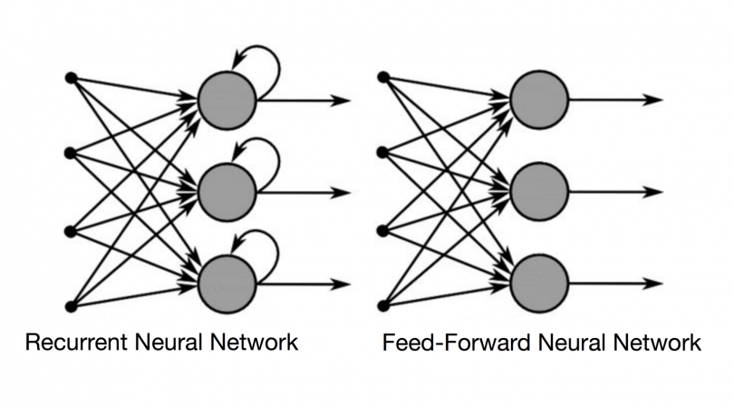
Recurrent Neural Networks
The two images below illustrate the difference in information flow between a RNN and a feed-forward neural network.
A recurrent neural network, however, is able to remember those characters because of its internal memory. It produces output, copies that output and loops it back into the network.
Therefore, a RNN has two inputs: the present and the recent past. This is important because the sequence of data contains crucial information about what is coming next.

Slide 29
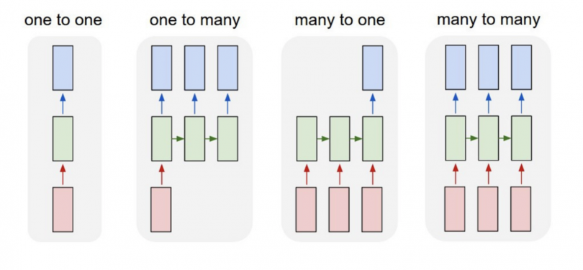
Recurrent Neural Networks
Also while feed-forward neural networks map one input to one output, RNNs can map one to many, many to many (translation) and many to one.
Recurrent networks can be trained with the Back-propagation algorithm.
At each step, we compute the activations of the output units with the desired activations and propagate errors backward through the network.
When training is completed, the network will be capable of performing a sequence of actions.

Slide 30
Applications of Neural Networks
Image Processing and Character recognition:
Given ANNs ability to take in a lot of inputs, process them to infer hidden as well as complex, non-linear relationships, ANNs are playing a big role in image and character recognition.
Character recognition like handwriting has lot of applications in fraud detection (e.g. bank fraud) and even national security assessments.
Image recognition is an ever-growing field with widespread applications from facial recognition in social media, cancer detention in medicine to satellite imagery processing for agricultural and defense usage.
Forecasting:
Forecasting is required extensively in everyday business decisions (e.g. sales, financial allocation between products, capacity utilization), in economic and monetary policy, in finance and stock market.
More often, forecasting problems are complex, for example, predicting stock prices is a complex problem with a lot of underlying factors

Slide 31
Applications of Neural Networks
Speech Recognition:
Speech recognition has many applications, such as home automation, mobile telephony, virtual assistance, hands-free computing, video games, and so on. Neutral networks are widely used in this area.
We can say its a direct example of applications in virtual assistants or chatbots.
Nowadays, Google smart home, Alexa, Siri, Google assistance or Cortana are known to most of us.
Text Classification and Categorization:
Text classification is an essential part of document search and filtering, online web searches and language identification and sentiment analysis.
Neural networks are actively used for this kind of task. Named entity recognition and parts of speech tagging are some of the application that comes under the domain of Natural Language Processing (NLP).
The widely used models are Recurrent Neural Networks (RNN) and Long-Short Term Memory (LSTM) networks. Though, CNN is also used for some of the applications.

Slide 32
Applications of Neural Networks
Image classification or labelling:
Convolution Neural Network or Feed-forward neural network with back-propagation is generally used for image classification.
There are many other models also, but one needs to select a model based on the dataset for training and features of interest.
Transfer learning can be done using any pre-trained model if the dataset of your problem is similar to the dataset of the pre-trained model that you are choosing.
There are many pre-trained image classification models that are trained on millions of images of different hundreds and thousands of classes. Some of the models are ResNet, GoogLeNet, InceptionV3, VGG16, ImageNet and many more are available.
Language Generation and Document Summarization:
Natural Language Generation and Paraphrasing and document summarization are widely used to generate the documents and summarize multi-documents.
Their applications can be found in generating text-based reports from data tables, automated reports writing, summarizing medical reports, generating stories and novels, etc.

Slide 33
Applications of Neural Networks
Object detection:
Object detection from images is widely used to detect any object and classify it based on that.
It needs large training dataset with all the coordinates of the object of interest clearly specified. The widely used object detection models are YOLO (You Only Look Once) and SSD (Single Shot Object Detectors).
Healthcare:
Artificial Neural Networks are used in Oncology to train algorithms that can identify cancerous tissue at the microscopic level at the same accuracy as trained physicians.
Various rare diseases may manifest in physical characteristics and can be identified in their premature stages by using Facial Analysis on the patient photos.
So the full-scale implementation of Artificial Neural Networks in the healthcare environment can only enhance the diagnostic abilities of medical experts and ultimately lead to the overall improvement in the quality of medical care all over the world.

Slide 34
Distributed Representation
The long term knowledge of a connectionist model is stored as a set of weights on connections between units.
Connectionist networks can be divided into two classes:
Those that uses localist representations and
Those that use distributed representation
Distributed representation is generally defined to have the following properties
A concept is represented by a pattern of activity over a collection of neurons (i.e., more than one neuron is required to represent a concept).
Each neuron participates in the representation of more than one concept.
By contrast, in localist representation, a single neuron represents a single concept on a stand-alone basis.
Distributed representations use patterns of activations over many units.

Slide 35
Distributed Representation
These representations are distributed, which typically has the consequence that interpretable information cannot be obtained by examining activity of single hidden units.
With a local representation, activity in individual units can be interpreted directly, but with distributed coding individual units cannot be interpreted without knowing the state of other units in the network.
Another equivalent property is that in a distributed representation, one cannot interpret the meaning of activity on a single neuron in isolation: the meaning of activity on any particular neuron is dependent on the activity in other neurons.
Thus, the fundamental difference between localist and distributed representation is only in the interpretation and meaning of the units.

Slide 36
Characteristics of Distributed Representation
Representational efficiency:
Distributed representation is computationally attractive because it can store multiple concepts using a small set of neurons.
With n binary output neurons, it can represent 2n concepts because that many different patterns are possible with that collection of binary neurons.
With localist representation, n neurons can only represent n concepts.
Mapping efficiency:
Distributed representation allows for a more compact overall structure (mapping function) from input nodes to the output ones and that means less number of connections and weights to train.
Such a mapping function requires less training data and will generalize better.
Sparse distributed representation:
A distributed representation is sparse if only a small fraction of the n neurons is used to represent a subset of the concepts.

Slide 37
Characteristics of Distributed Representation
Resiliency:
Distributed representations are more resistant to damage.
A distributed representation based mapping function is resilient in the sense that degradation of a few elements in the network structure may not disrupt or effect the overall performance of the structure.

Slide 38
Localist Representation
In addition to being more robust than localist representation, distributed representation can also be more efficient.
Consider the problem of describing the locations of objects (2, 3) on a two-dimensional 8 by 8 grid.
Localist Representation
More efficient Representation with 16 units
8
8
 | X
7
7
6
6
5
5
4
4
3
3
2
2
1
1
1
2
3
4
5
6
7
8
1
2
3
4
5
6
7
8

Slide 39
Distributed representation using coarse coding
There is a distributed representation for this called coarse coding, in which we divide the space of possible object locations into a number of large, overlapping circular zones.
Units are depicted with small dots and their receptive fields as large circles.
8
7
6
5
4
3
2
1
1
2
3
4
5
6
7
8
Distributed representation using coarse coding

Slide 40
Distributed representation using coarse coding
A unit becomes active if any object is located within its receptive field. There is a unit associated with each zone- the zone is called unit’s receptive field.
The intersection of several circular zones associated with a group of units may be a very small area, if only those unites are active, we can be precise about where the object is located.
As the receptive fields become larger, i.e., as the individual units become less discriminating about object location, the whole representation becomes more accurate, because the regions of intersection become smaller.
Hence, we can represent multiple objects with some more precision.
One drawback of distributed representation is that they can not store many densely packed objects.
A distributed scheme would be confounded by the loss of information caused by the effect of many objects on a single unit’s receptive field.

Slide 41
Connectionist AI And Symbolic AI
Symbolic AI
Search – state space traversal
Knowledge representation – predicate logic, semantic frames, scripts
Learning – macro-operators, explanation learning, version space
Symbolic AI goes by several other names, including rule-based AI, classic AI and good old-fashioned AI (GOFAI).
Much of the early days of artificial intelligence research centered on this method, which relies on inserting human knowledge and behavioral rules into computer codes.
Humans regularly use symbols to assign meaning to the things and events in their environment.
For example, if someone told a friend they just purchased a bouquet of roses, the person hearing that news could quickly conjure an image of the flowers. The idea behind symbolic AI is that these symbols become the building blocks of cognition.

Slide 42
Connectionist AI And Symbolic AI
An application made with this kind of AI research processes strings of characters representing real-world entities or concepts through symbols. The symbols can be arranged hierarchically or through lists and networks. Such arrangements tell the AI algorithm how the symbols relate to each other.
Processing of the information happens through something called an expert system. It contains if/then pairings that instruct the algorithm how to behave.
Symbolic AI works well with applications that have clear-cut rules and goals. If an AI algorithm needs to beat a human at chess, a programmer could teach it the specifics of the game. That framework gives the AI the boundaries within which to operate.
However, it falls short in applications likely to encounter variations. For example, a machine vision program might look at a product from several possible angles. It's time-consuming to create rules for every possibility. The real world has a tremendous amount of data and variations, and no one could anticipate all fluctuations in a given environment.

Slide 43
Connectionist AI And Symbolic AI
Connectionist AI
Search – Parallel Relaxation
Knowledge representation – very large number of real value connection strength,
Learning – back propagation, reinforcement learning, unsupervised learning
Although people focused on the symbolic type for the first several decades of artificial intelligence's history, a newer model called connectionist AI is more popular now.
It models AI processes based on how the human brain works and its interconnected neurons.
A system built with connectionist AI gets more intelligent through increased exposure to data and learning the patterns and relationships associated with it.
In contrast, symbolic AI gets hand-coded by humans. One example of connectionist AI is an artificial neural network. Each one contains hundreds of single units, artificial neurons or processing elements.

Slide 44
Connectionist AI And Symbolic AI
Connectionist AI is a good choice when people have a lot of high-quality training data to feed into the algorithm.
Although this model gets more intelligent with increased exposure, it needs a foundation of accurate information to start the learning process.
The health care industry commonly uses this kind of AI, especially when there is a wealth of medical images to use that humans checked for correctness or provided annotations for context.
However, it often cannot explain how it arrived at a solution.

Slide 45
Thank You!

